Slide 1

RUNGTA COLLEGE OF DENTAL SCIENCES & RESEARCH
CLEFT LIP AND PALATE
DEPARTMENT OF PEDODONTICS AND PREVENTIVE DENTISTRY

Slide 2
Specific learning Objectives
Core areas | Domain
Introduction Cleft lip and palate etiology Development of palate Classification of cleft | Age specific intervention Branch specific intervention

Slide 3
CATEGORY
MUST TO KNOW
NICE TO KNOW
Paranatal attitude
DESIRE TO KNOW
Management of cleft lip and palate
Pathogenesis of clefting
Incident of cleft
Age specific intervention

Slide 4
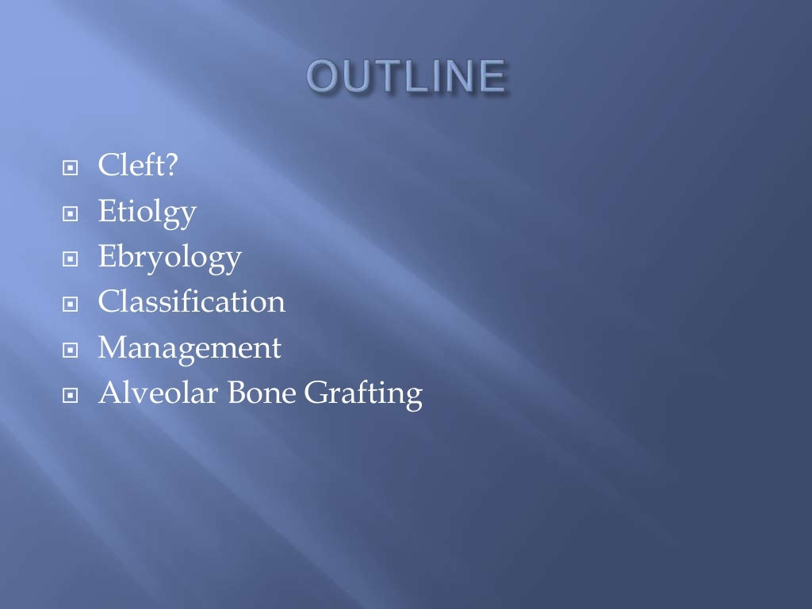

Slide 5
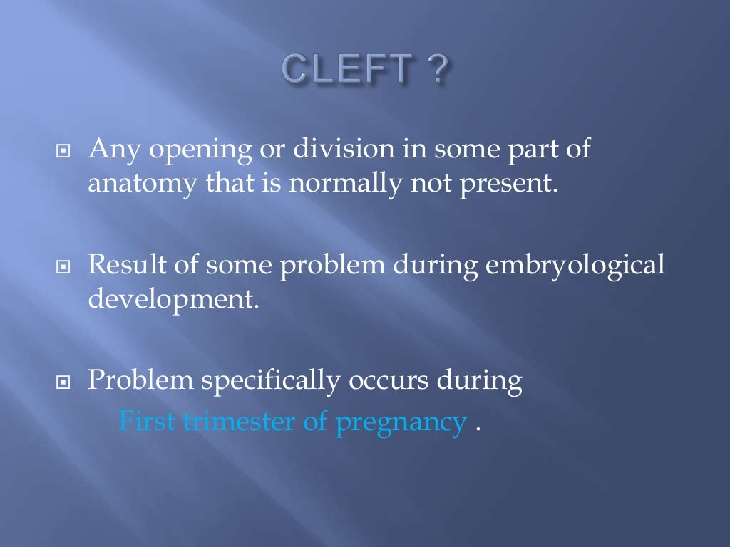

Slide 6
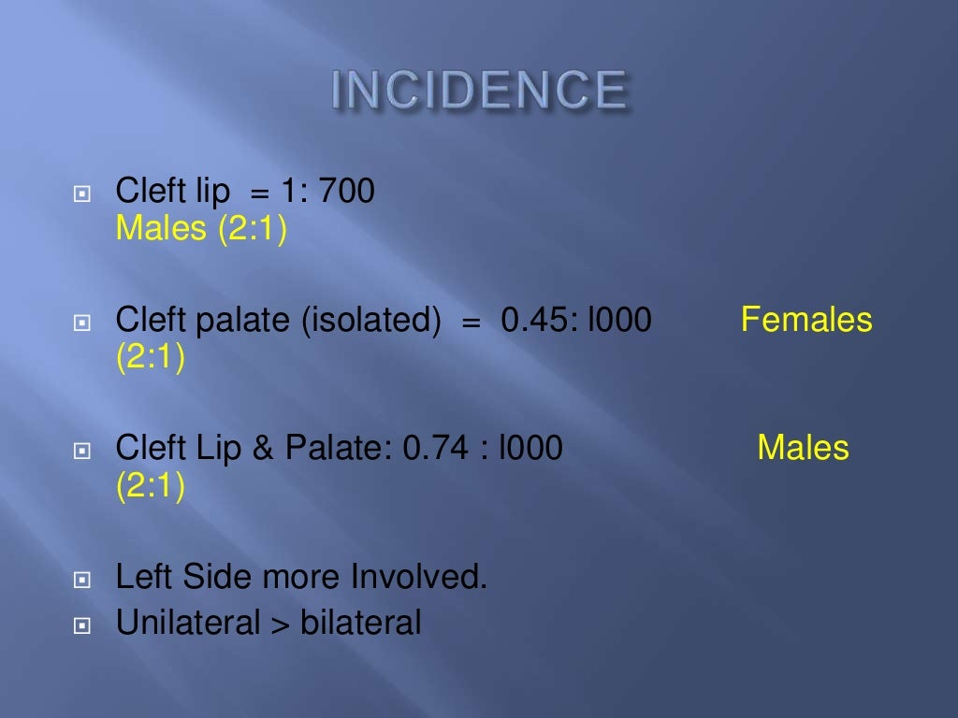

Slide 7
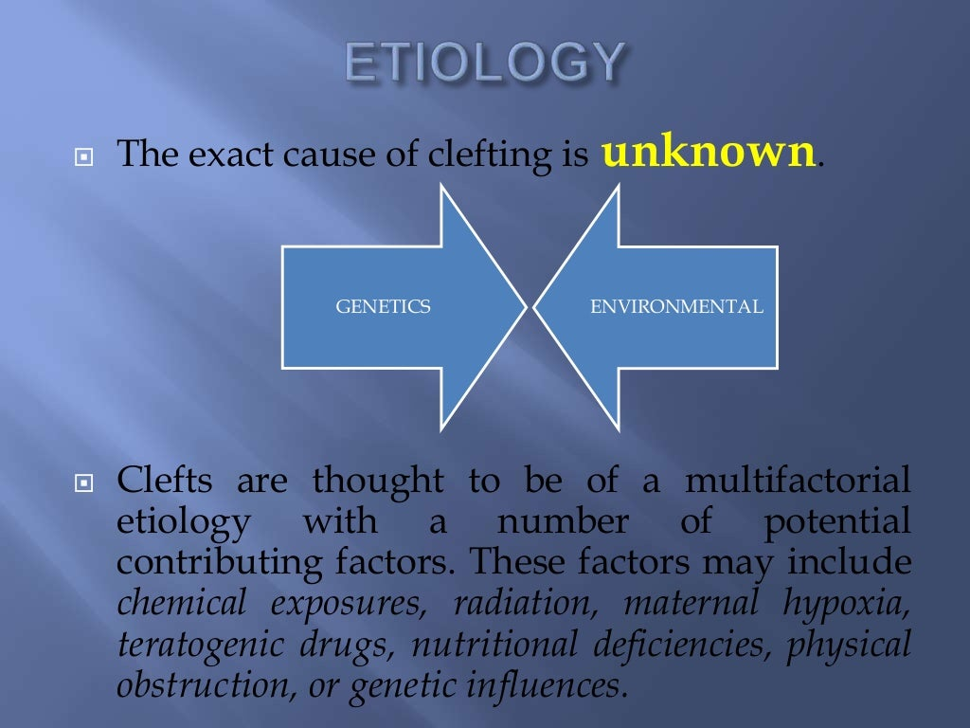

Slide 8
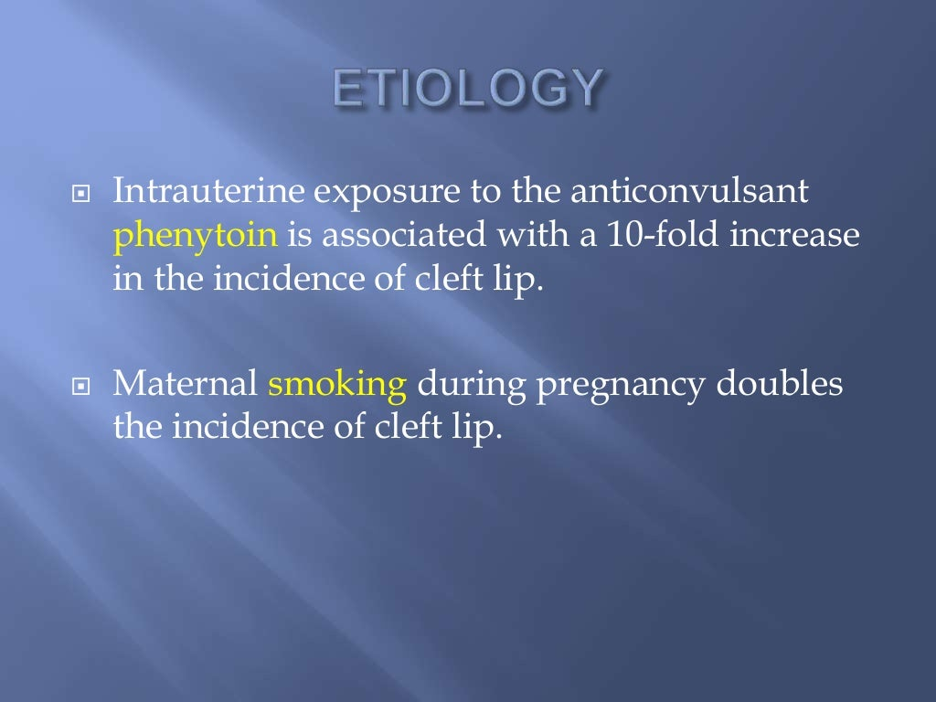

Slide 9
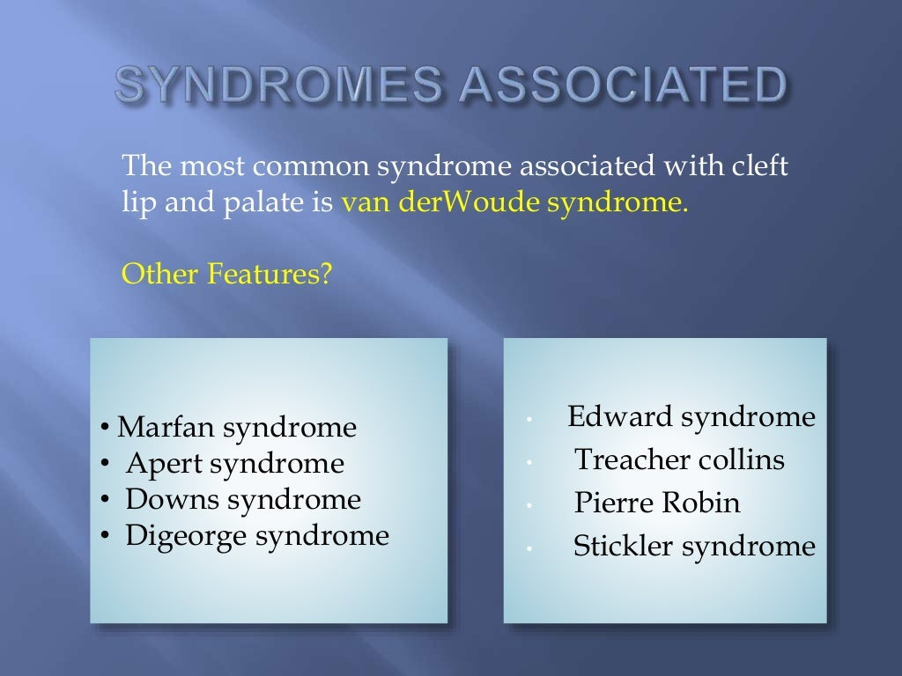

Slide 10
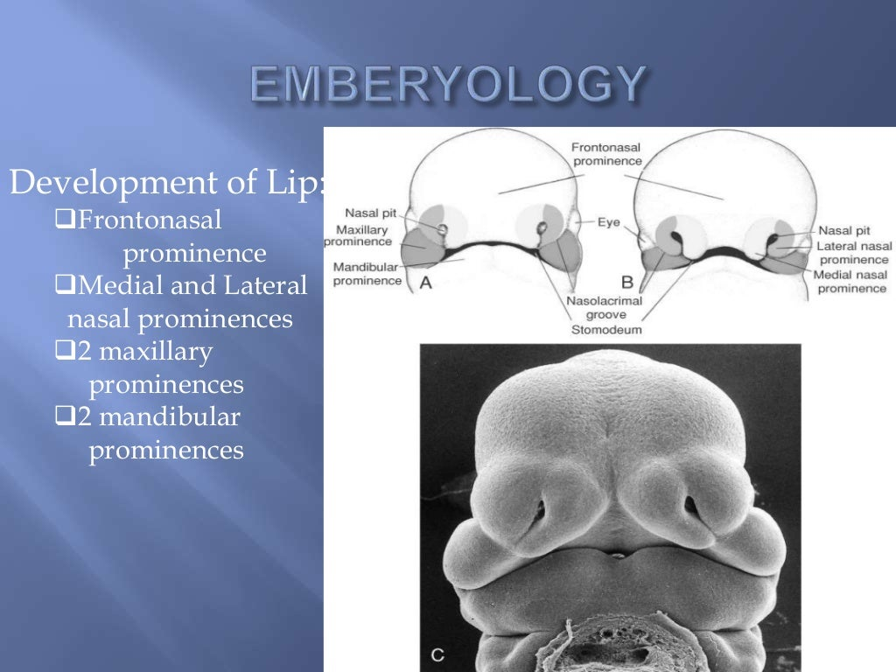

Slide 11
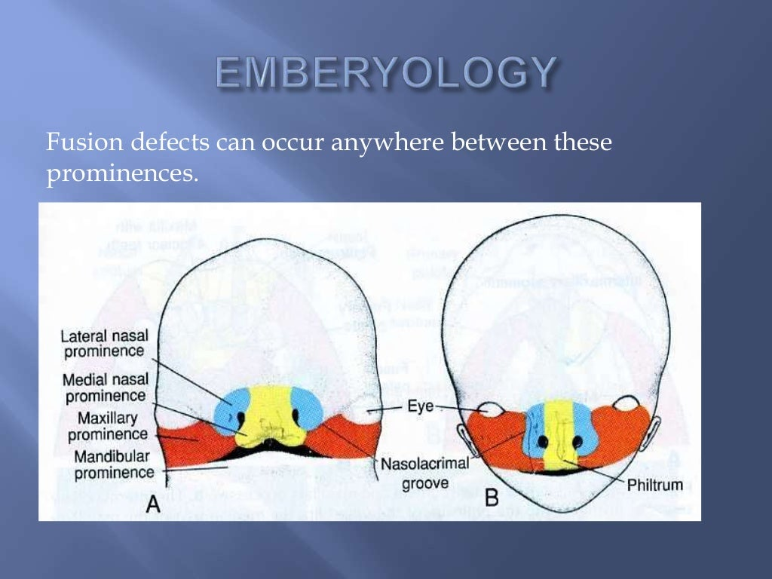

Slide 12
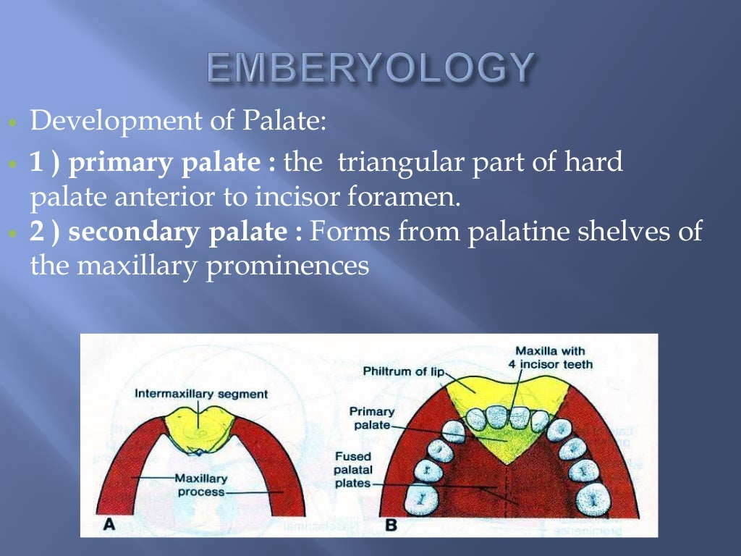

Slide 13
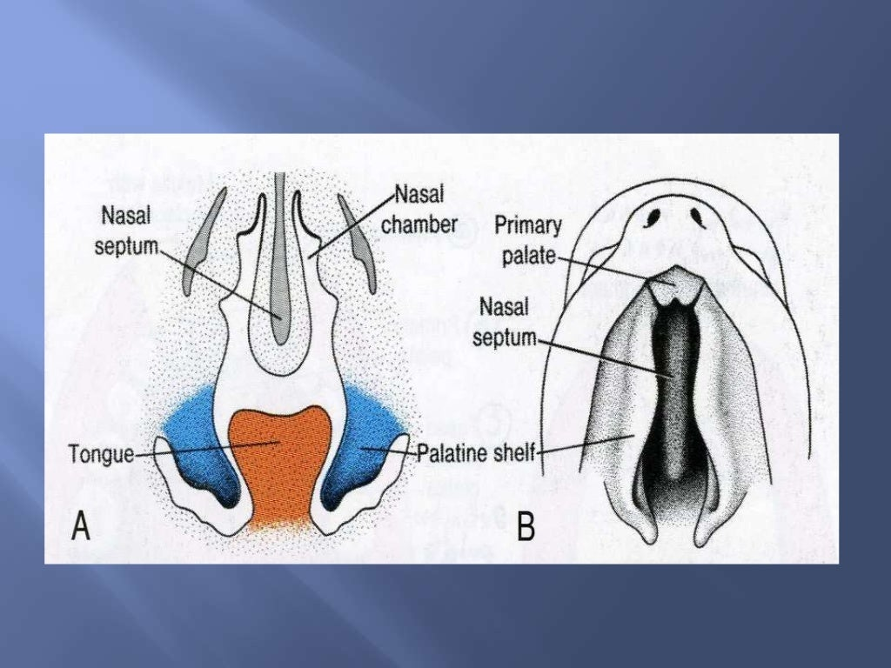

Slide 14
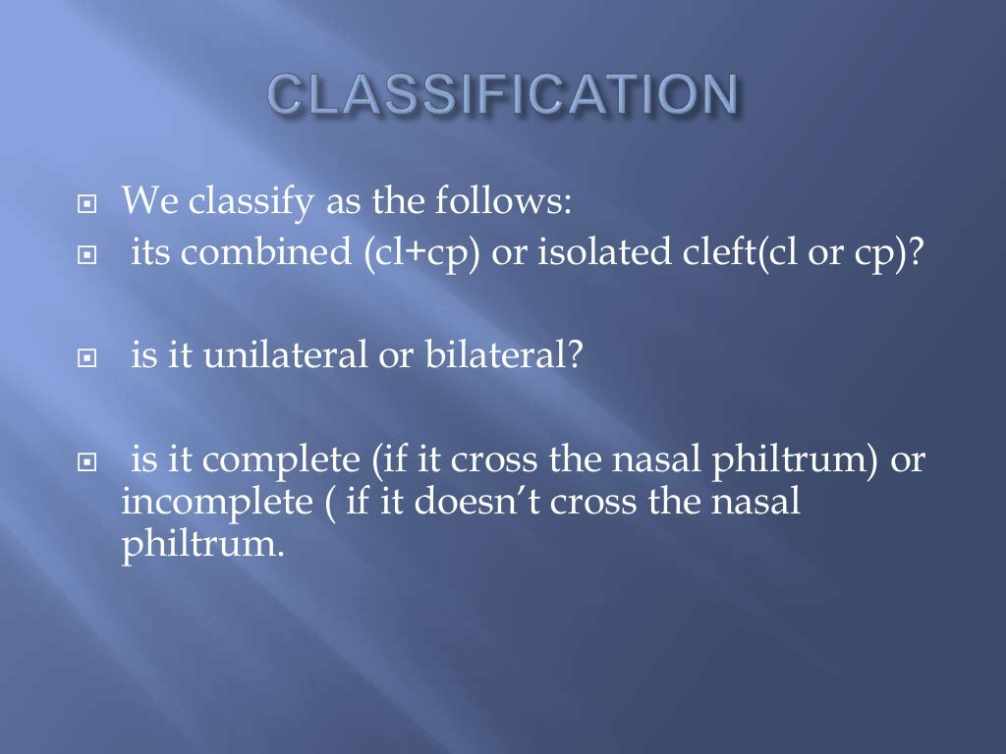

Slide 15
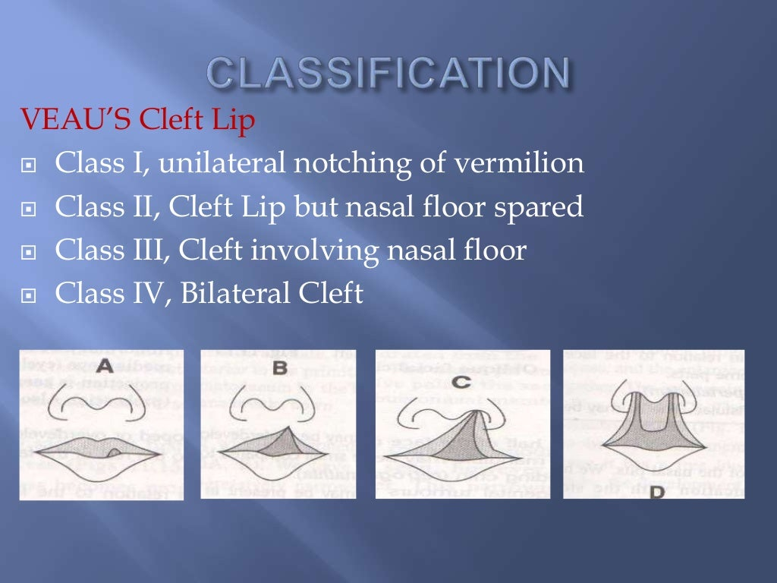

Slide 16
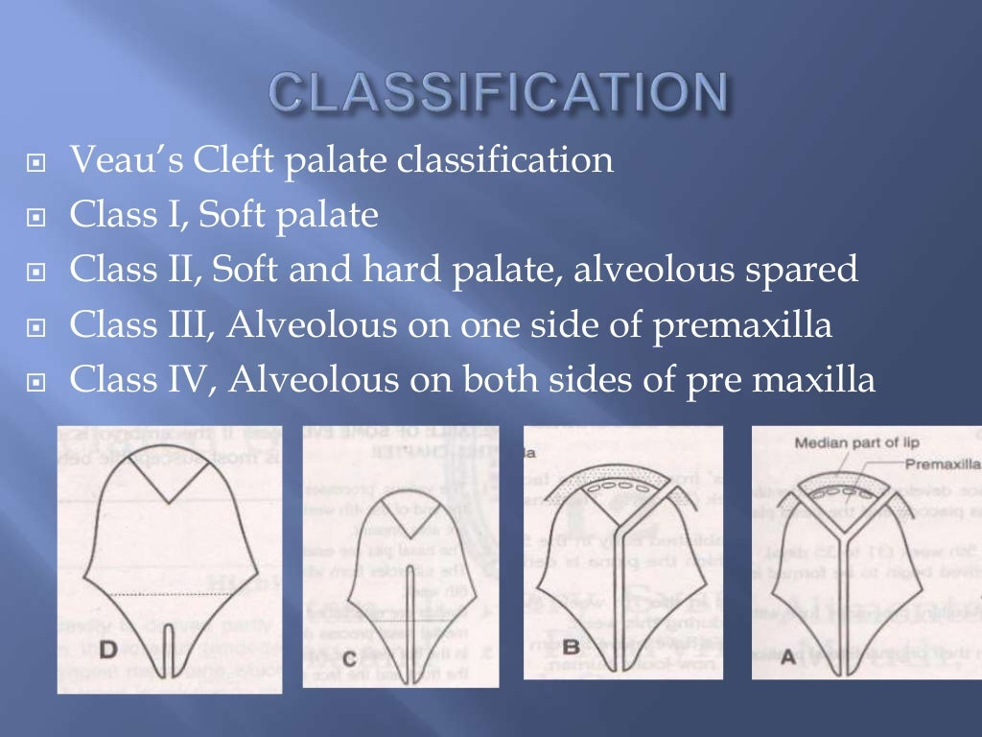

Slide 17
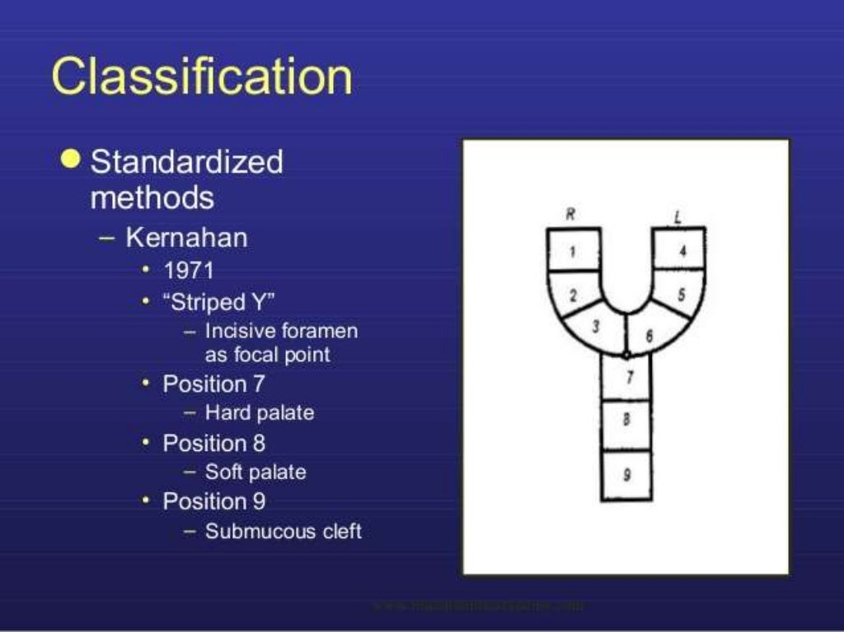

Slide 18
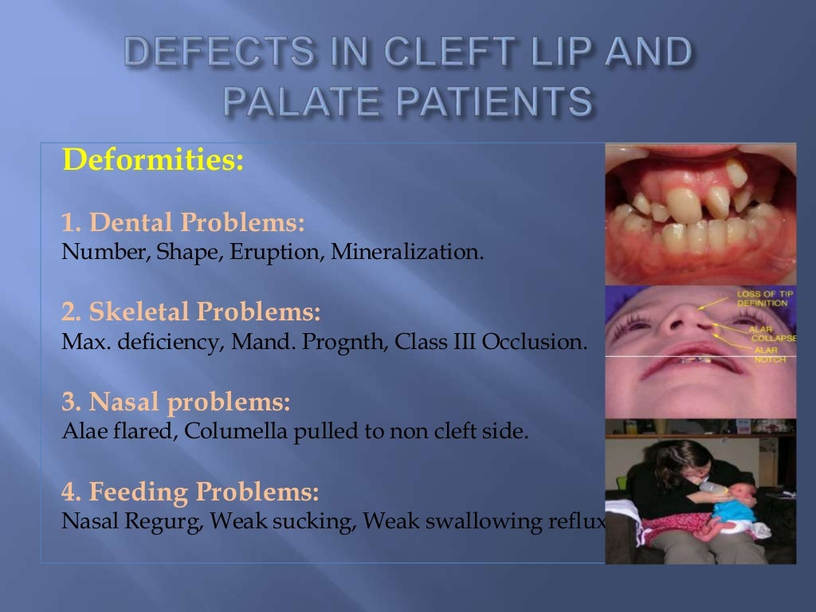

Slide 19
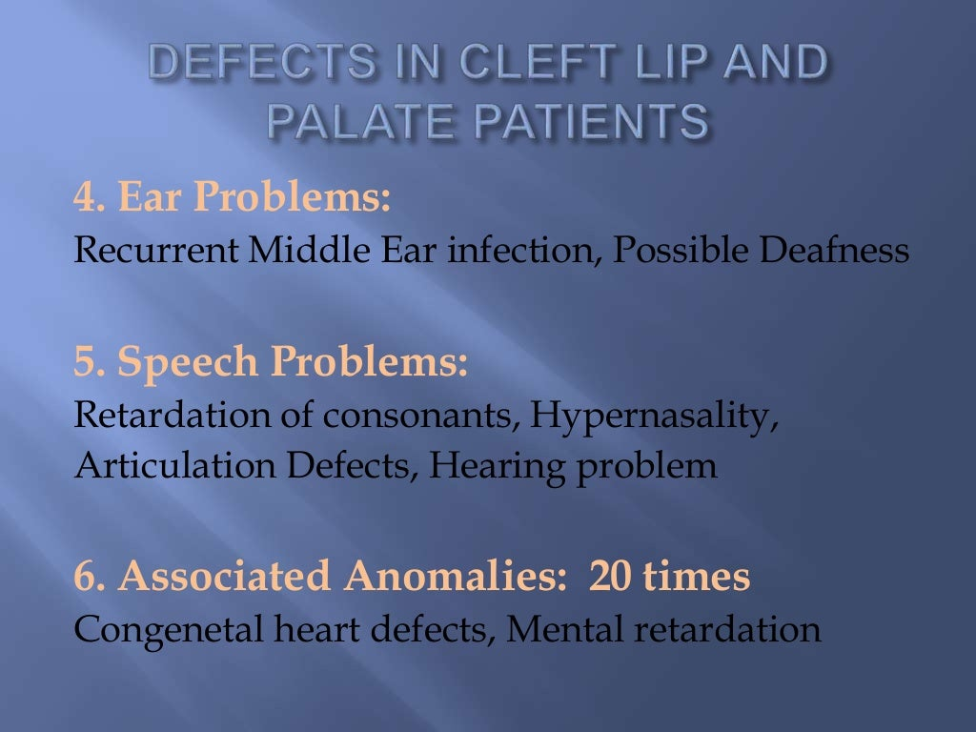

Slide 20
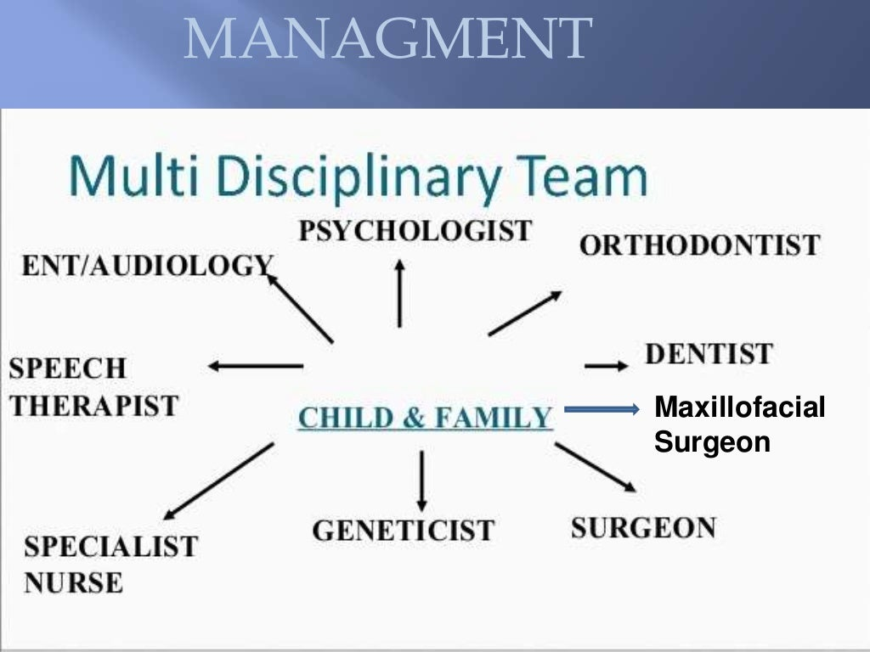

Slide 21
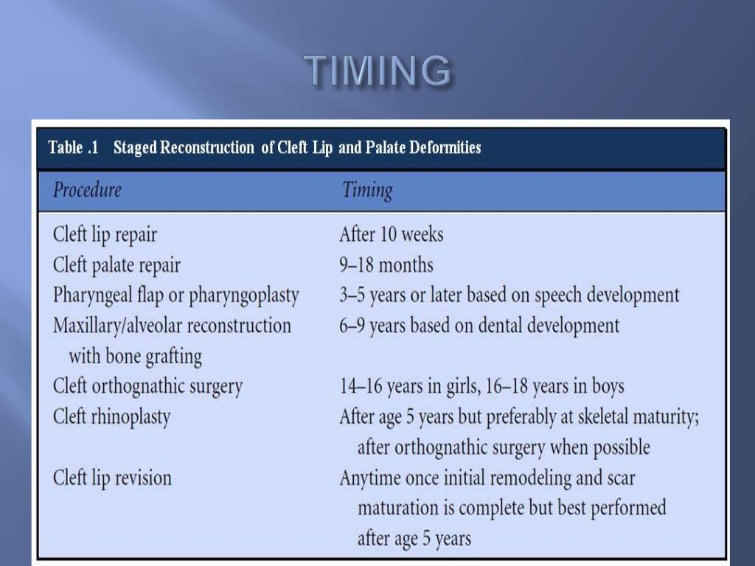

Slide 22
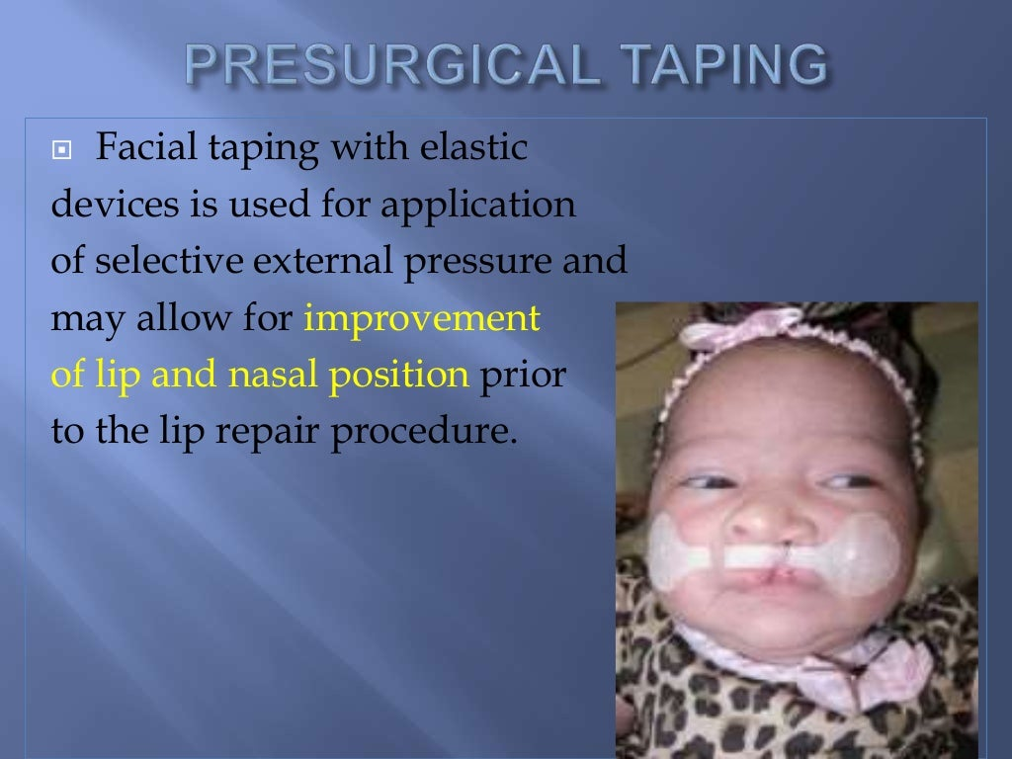

Slide 23
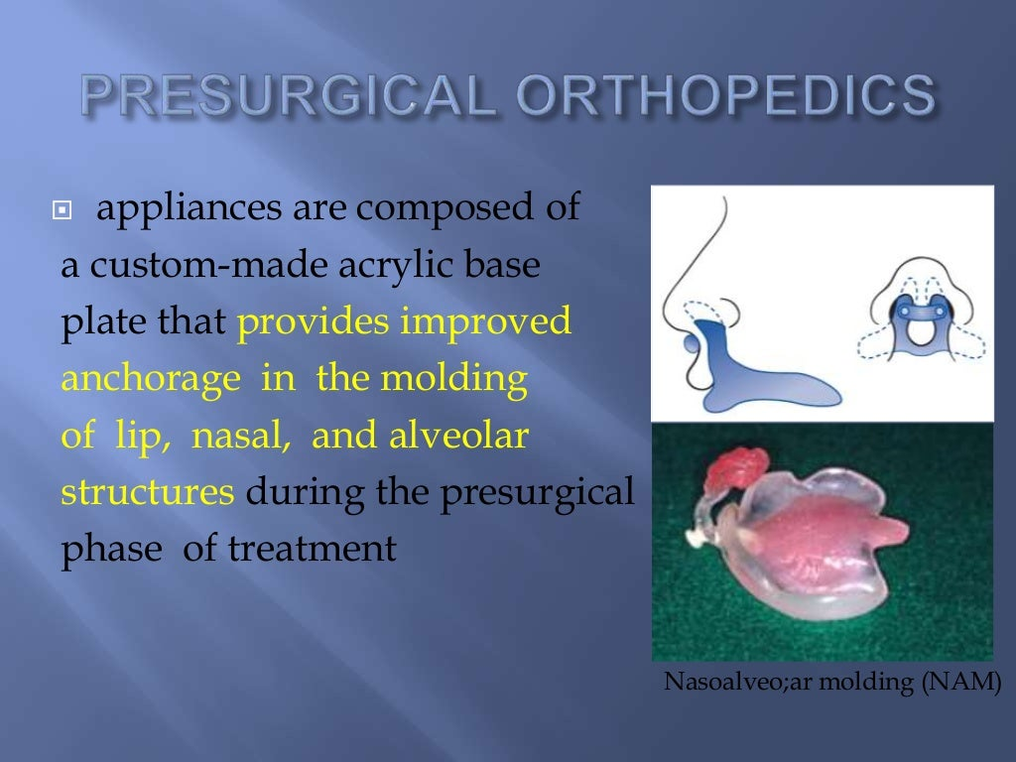

Slide 24
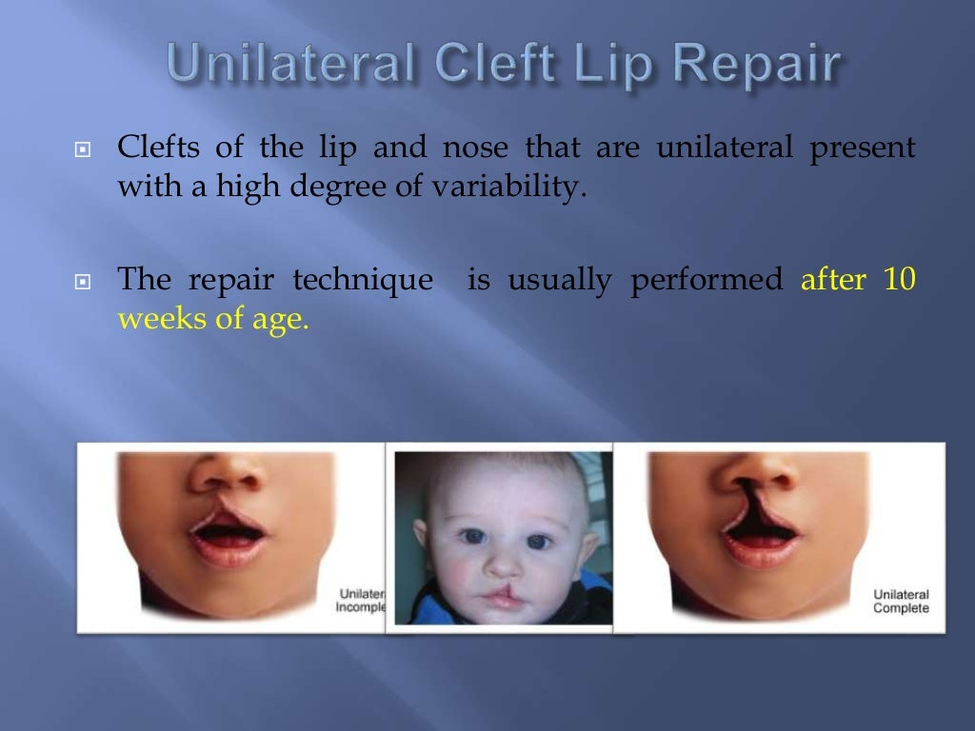

Slide 25
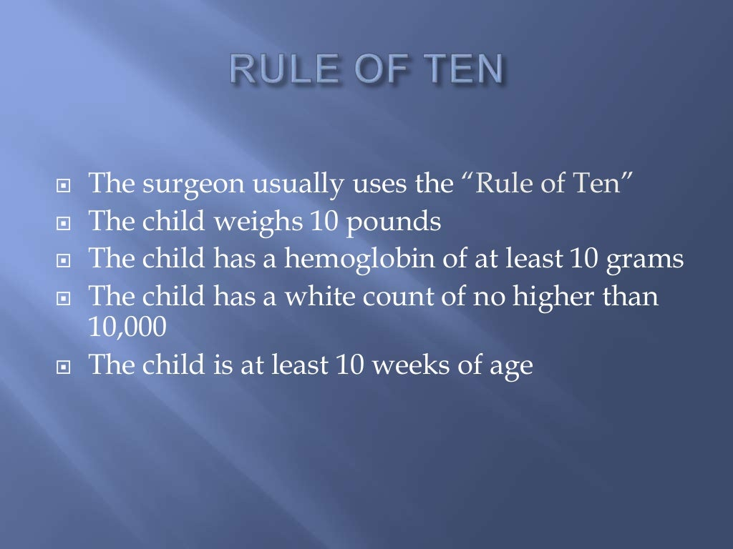

Slide 26
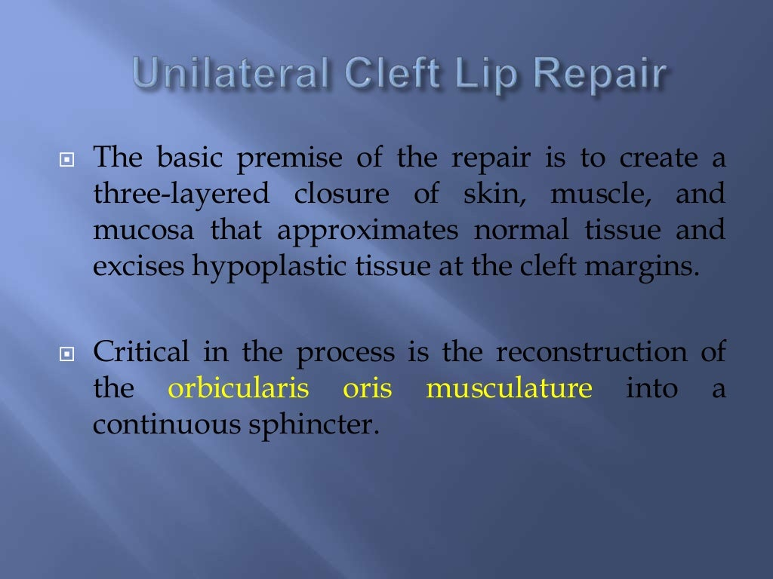

Slide 27
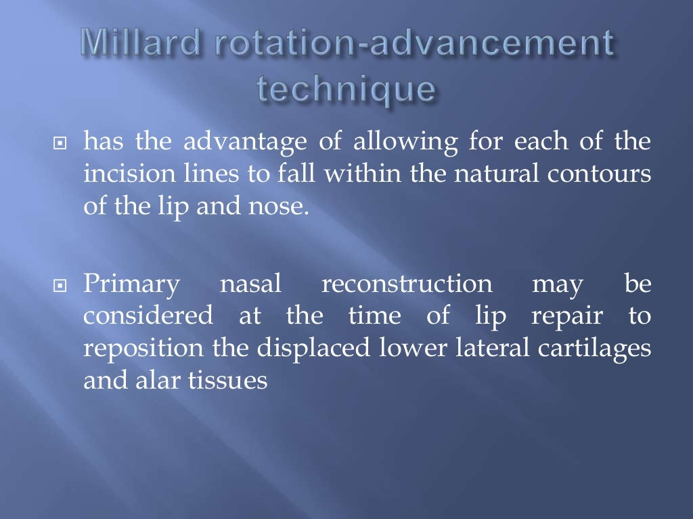

Slide 28
